Slide 1
TRAINITY PROJECT 4
HIRING PROCESS ANALYTICS

Slide 2

AGENDA
PROJECT DESCRIPTION
APPROACH
TECH-STACK USED
INSIGHTS
RESULT

Slide 3
PROJECT DESCRIPTION
Objective of this project is to analyze the company's hiring process data and draw meaningful insights from it.
The hiring process is a crucial function of any company, and understanding trends such as the number of rejections, interviews, job types, and vacancies can provide valuable insights for the hiring department.
As a data analyst, we received a dataset containing records of previous hires. So our job is to analyze this data and answer certain questions that can help the company improve its hiring process.
Hyperlink to excel sheet- https://docs.google.com/spreadsheets/d/1uy8e257fElUe8rbAj9Iikg9hY5oOAgPq/edit?usp=drive_link&ouid=114522139830880122868&rtpof=true&sd=true

Slide 4
APPROACH
1. Preparing the data- This step includes cleaning the data, removing or handling missing data, rectifying errors and typos, detecting and removing/replacing outliers and removing duplicate values(if any).
2. Analysing the data- This step includes understanding and analysing the data and draw meaningful insights from the data and finally visualize it.
3. Report- As a data analyst we will derive the desired insights and prepare a brief report for the management and hiring team.

Slide 5
TECH-STACK USED
Microsoft Excel 2016- Here Microsoft Excel is used to filter data and plot graphs to get insights about hiring process of the organization.

Slide 6
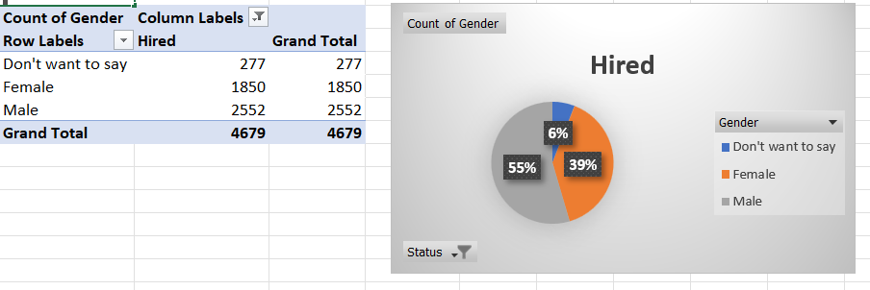
A. Hiring Analysis: The hiring process involves bringing new individuals into the organization for various roles. Your Task: Determine the gender distribution of hires. How many males and females have been hired by the company?
INSIGHT- There are total 4679 candidates hired in the company out of which 55% are males, 39% are females and 6% do not want to disclose their gender.

Slide 7
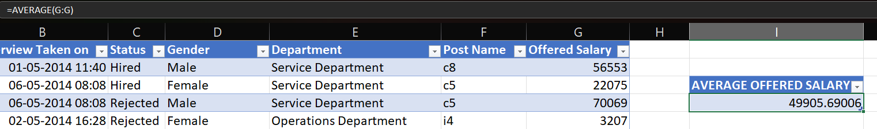
B. Salary Analysis: The average salary is calculated by adding up the salaries of a group of employees and then dividing the total by the number of employees. Your Task: What is the average salary offered by this company? Use Excel functions to calculate this.
INSIGHTS- The average of the salary offered to the employees of the company is 49905.6 currency units.

Slide 8
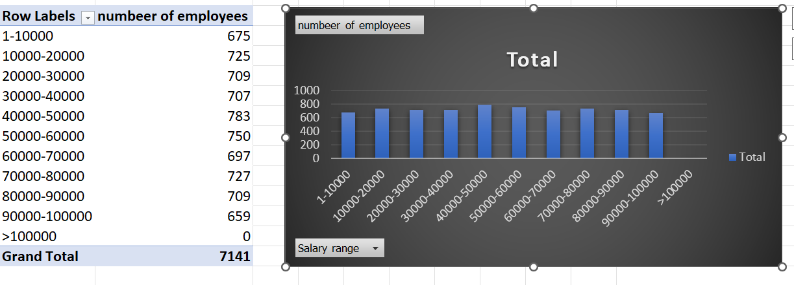
C. Salary Distribution: Class intervals represent ranges of values, in this case, salary ranges. The class interval is the difference between the upper and lower limits of a class. Your Task: Create class intervals for the salaries in the company. This will help you understand the salary distribution.

Slide 9
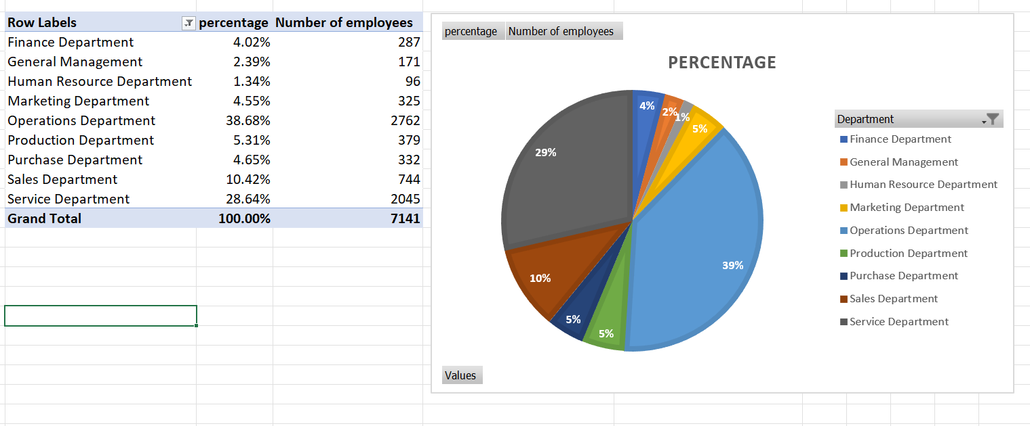
D. Departmental Analysis: Visualizing data through charts and plots is a crucial part of data analysis. Your Task: Use a pie chart, bar graph, or any other suitable visualization to show the proportion of people working in different departments.

Slide 10
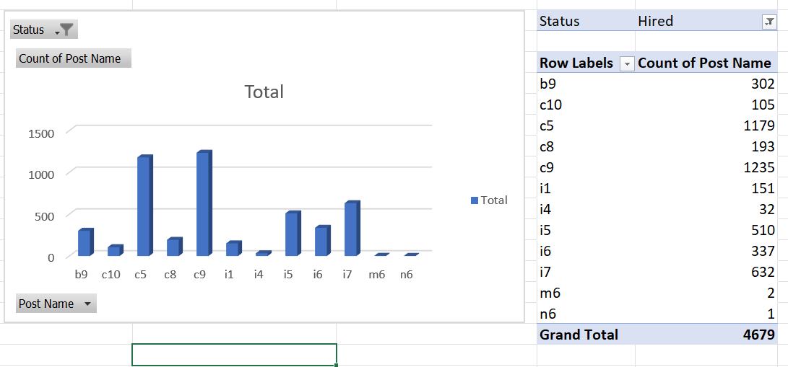
E. Position Tier Analysis: Different positions within a company often have different tiers or levels. Your Task: Use a chart or graph to represent the different position tiers within the company. This will help you understand the distribution of positions across different tiers.
Insight- Here, we can observe that the organization has hired most candidates for post tier c9 followed by c5 and then i7 at distant third.

Slide 11
RESULT- In this project we got insights about various questions like gender distribution of hired candidates, average salary offered vs. average salary of hired candidates, salary distribution of offered jobs vs. salary distribution of hired candidates, department and post tier wise distribution of hired candidates etc. from which we were able to derive meaningful conclusions. Our insights could potentially help the company improve its hiring process and make better hiring decisions in the future.

